Slide 1
Chapter 1 - An Introduction to Large Language Models
From the book Hands-On Large Language Models

Slide 2
What is Artificial Intelligence?
Used to describe computer systems dedicated to performing tasks close to human intelligence
In this course, we will be mostly focusing on Language AI
Language AI is a subfield of AI that focuses on developing technologies capable of understanding, processing, and generating human language.

Slide 3
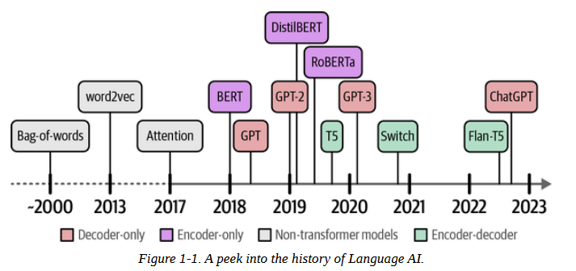
Recent History of Language AI

Slide 4
Representing Language as Bag-of-Words
Text or human language cannot be directly processed by language models.
Because of this, ways to represent language into 0s and 1s have been proposed.
The history of Language AI starts with a technique called bag-of-words, a method for representing unstructured text.

Slide 5
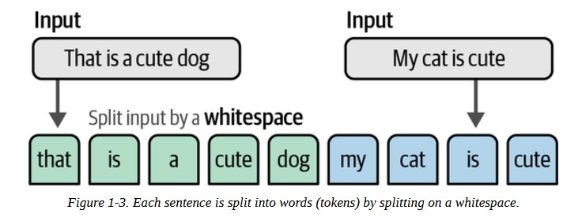
Representing Language as Bag-of-Words
Bag-of-words works as follows: suppose we have two sentences for which we want to create numerical representations.
The first step is tokenization - the process of splitting up sentences or text into individual units called tokens, as illustrated below

Slide 6
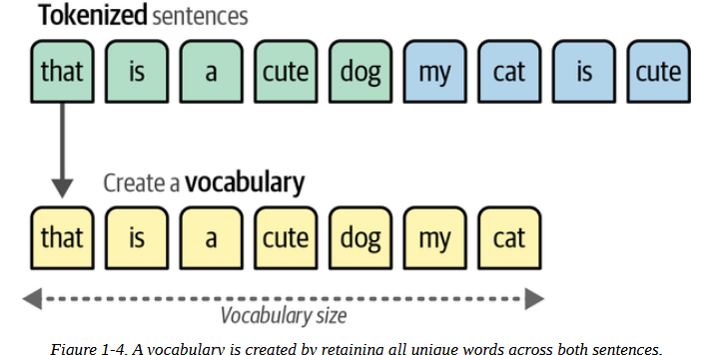
Representing Language as Bag-of-Words
after tokenization, we combine all unique words from each sentence to create a vocabulary used to represent the sentences, as illustrated in the figure below.
Note: vocabulary is created during the training

Slide 7
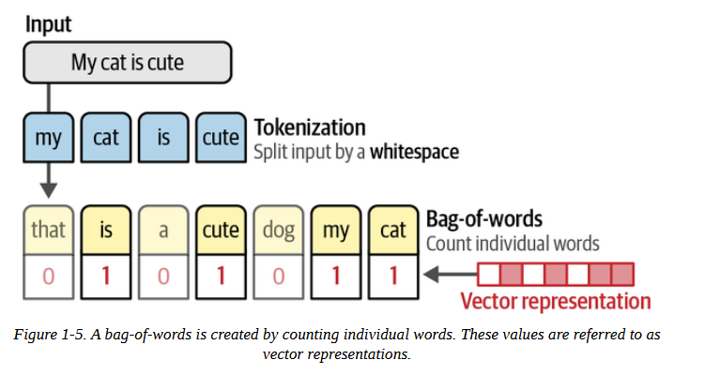
Representing Language as Bag-of-Words
After building the vocabulary, vectorization happens.
This is when the trained model is used to create representations of the input text.

Slide 8
Representing Language as Bag-of-Words
So, if the bag-of-words model has a vocabulary size ( # of unique tokens) of 200, a vector representation for any text would be of length 200, no matter the length of the input text.
If the input text has 3 vectors, 197 elements would be 0s and 3 would be 1s.
It is very sparse vector embedding.

Slide 9
Better Representations with Dense Vector Embeddings
In 2013, word2vec was released.
Unlike bag-f-words, word2vec captures the meaning of each word in embeddings.
Embeddings are vector representations of data that attempt to capture its meaning.
word2vec learns semantic relationships by training on vast amounts of textual data, like the entirety of Wikipedia using neural networks.

Slide 10
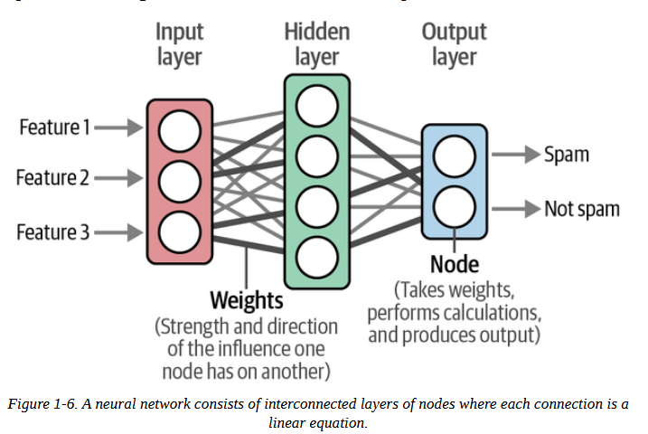
Better Representations with Dense Vector Embeddings
A quick reminder: Neural networks can have many layers where each connection has a certain weight. These weights are often referred to as the parameters of the model.

Slide 11
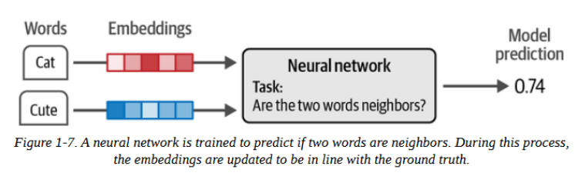
Better Representations with Dense Vector Embeddings
word2vec generates word embeddings by looking at which other words they tend to appear next to in a given sentence.

Slide 12
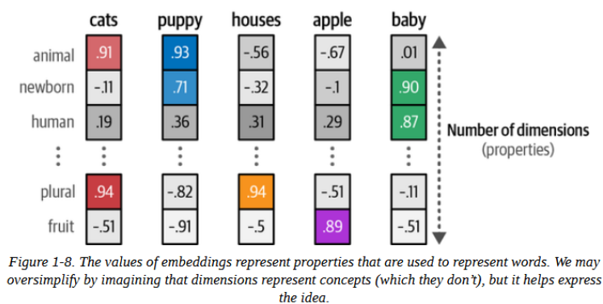
Better Representations with Dense Vector Embeddings
In embeddings, the number of dimensions indicate the number of semantic properties. This is illustrated below.
While the example shows properties humans can understand, this is seldom the case. Usually, these properties are obscure and would not make sense to humans.

Slide 13
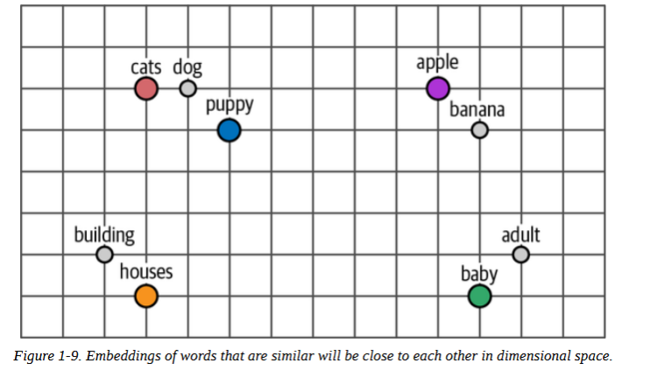
Better Representations with Dense Vector Embeddings
We can measure semantic similarity between 2 words or more.
The dimensions in a vector embedding represent coordinates in a dimensional space.
So, the closer the values are of two words with one another, the closer they are in the dimensional space, the more properties they share.

Slide 14
Encoding and Decoding Context with Attention
word2vec is effective at creating static representations of words, but it fails to capture their contextual meaning.
"bank" could mean a financial institution or a river bank.
Its meaning, and therefore its vector embedding, should change depending on the context.
To achieve this, recurrent neural networks (RNNs) was used. Unlike other neural networks, RNNs take sequence (order of words) as an additional input.

Slide 15
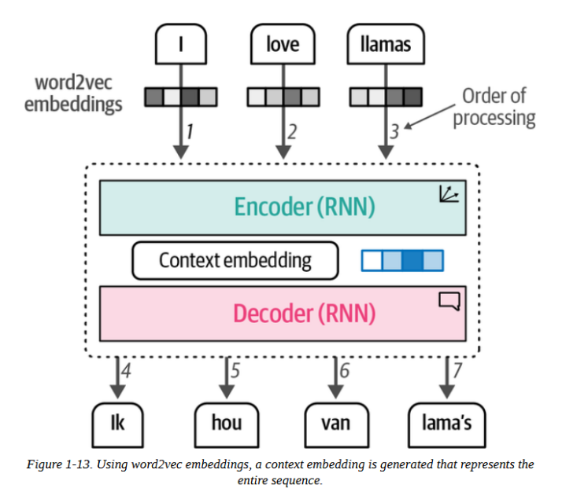
Encoding and Decoding Context with Attention
RNNs for language generation are used for 2 tasks:
Encoding: generating vector representations or embeddings of a text.
Decoding: generating language.
Each step is autoregressive - the input of the current step comes from the previous step's output.

Slide 16
Encoding and Decoding Context with Attention
the RNN creates embeddings for an entire input.
The encoder takes vector representations from word2vec and then creates the context embedding.
The issue with this, however, is that it can't handle long texts well.
A single embedding for a long sentence would not be able to represent information and meaning well.
To solve this, a solution called attention was introduced in 2014.

Slide 17
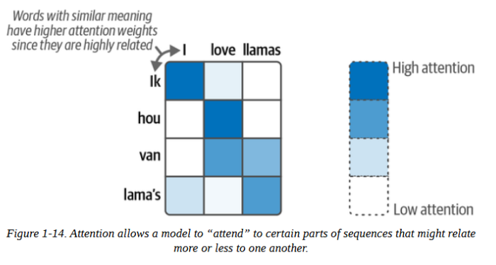
Encoding and Decoding Context with Attention
Attention allows a model to focus on parts of the input sequence that are relevant to one another ("attend" to one another), and amplify their signal.

Slide 18
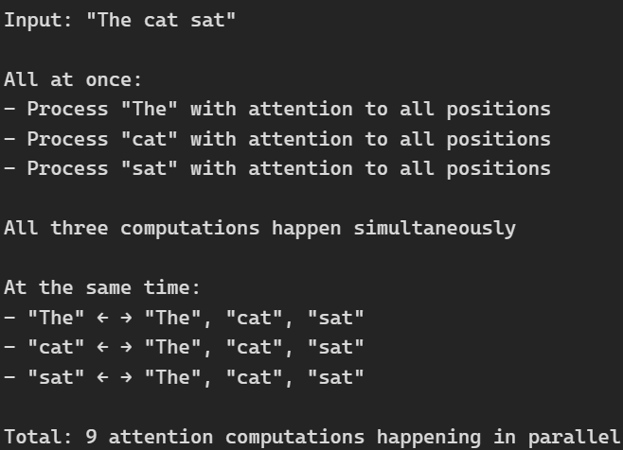
Attention Is All You Need
In 2017, attention was first explored in the "Attention is all you need" paper.
They proposed an NN called the Transformer, solely based on the attention mechanism and removed the RNN.
Compared to the recurrence network, the Transformer could be trained in parallel, which speeds up training.

Slide 19
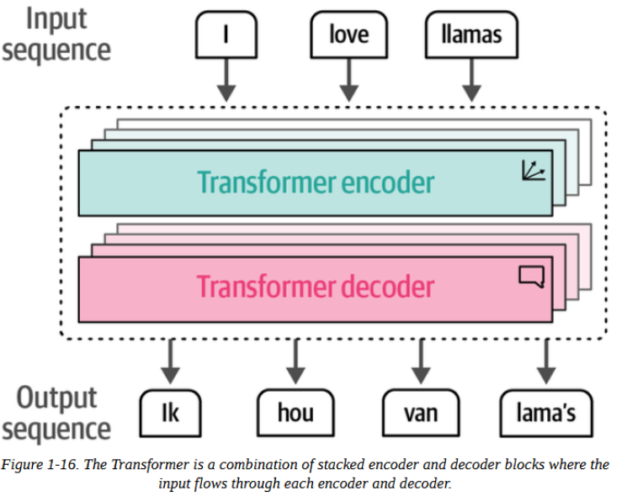
Attention Is All You Need
In the Transformer, the encoder and decoder are stacked on top of each other
This architecture remains autoregressive, needing to consume each generated word before creating a new word.

Slide 20
Attention Is All You Need
In the Transformer, the encoder and decoder are stacked on top of each other
This architecture remains autoregressive, needing to consume each generated word before creating a new word.

Slide 21
Attention Is All You Need
Self-attention is the mechanism where each word looks at all other words in the input sentence to understand context and relationships.
Feedforward:
After self-attention, each word's representation passes through a simple neural network independently. This is just two linear transformations with a ReLU activation in between.

Slide 22
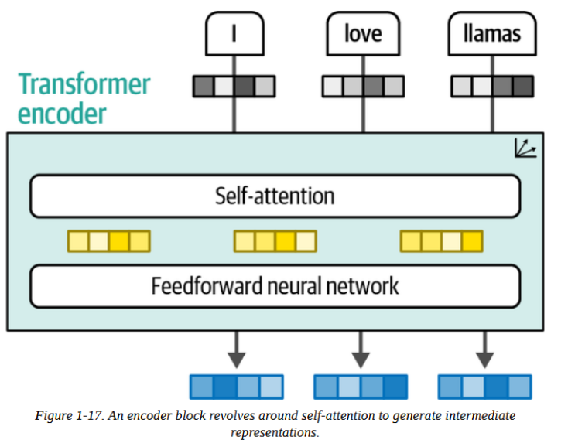
Attention Is All You Need

Slide 23
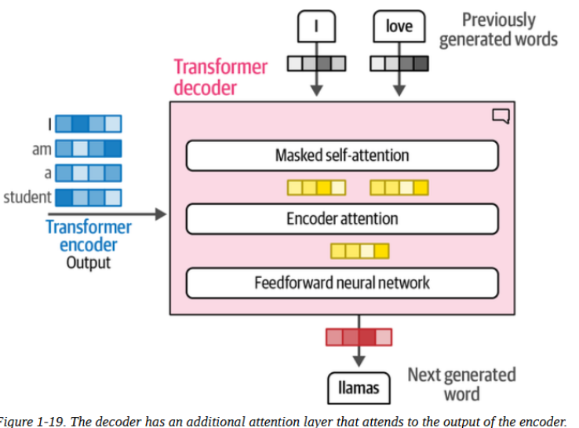
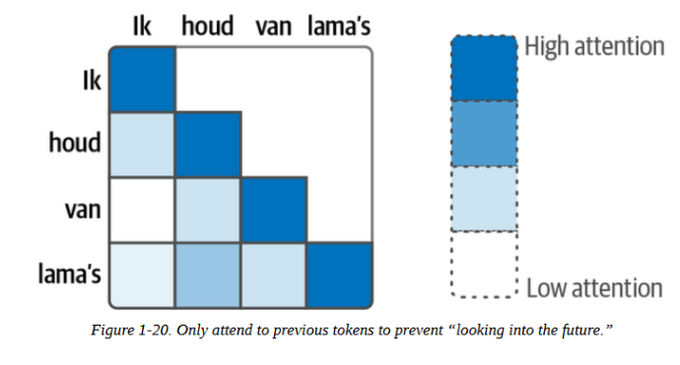
Attention Is All You Need
Unlike the encoder, the decoder part has an additional layer that pays attention to the output of the encoder.
The self-attention layer in the decoder masks future positions so it only attends to earlier positions to prevent leaking information when generating the output.

Slide 24
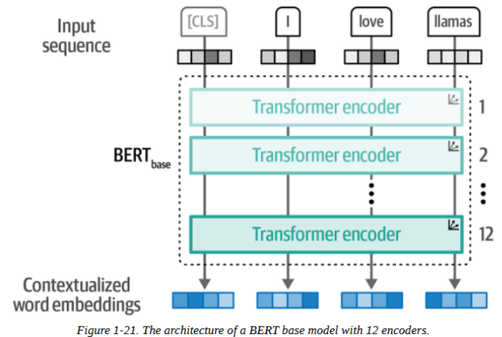
Representation Models: Encoder-Only Models
In 2018, a new architecture called Bidirectional Encoder Representations from Transformers (BERT) was introduced that could be used for a wide variety of tasks

Slide 25
Representation Models: Encoder-Only Models
Just like the encoder blocks in a the original transformer architecture, the encoder blocks here are the same.
Training these encoder stacks can be a difficult task that BERT approaches by adopting a technique called masked language modeling
While a transformer with a decoder predicts the next word, an encoder-only transformer takes context from previous and next words, or tokens, hence the use of the word 'bidirectional'.

Slide 26
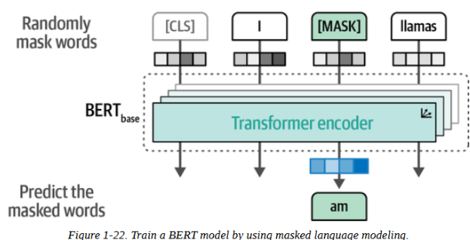
Representation Models: Encoder-Only Models
Input: "I [MASK] llamas"
Predicts: "love" (the MASKED word)
Uses BOTH left context ("I") AND right context ("llamas")

Slide 27
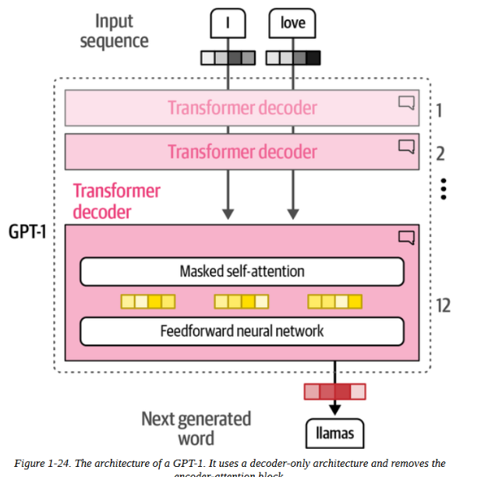
Generative Models: Decoder-Only Models
GPT (Generative Pre-trained Transformer) models are, in contrast to BERT, decoder-only models, and are aimed for generative tasks.

Slide 28
Generative Models: Decoder-Only Models
The decoder in a GPT architecture, unlike in the original transformer models where the decoder receives context from a separate encoder, processes input tokens directly through its own learned embedding layer (not word2vec).
GPT learns these embeddings during training as part of the model

Slide 29
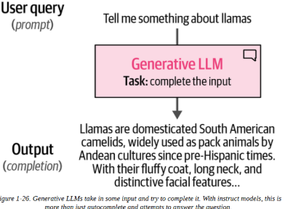
Generative Models: Decoder-Only Models
GPTs, or decoder-only models, are commonly referred to as large language models (LLMs).
Generative LLMs, as sequence-to-sequence machines, take in some text and attempt to autocomplete it.
You will often hear that generative models are completion models.

Slide 30
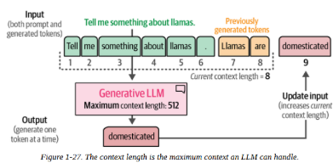
Generative Models: Decoder-Only Models
A vital part of these completion models is something called the context length or context window.
It represents the maximum number of tokens the model can process
When you’re using an LLM and receive a warning to open a new chat, it means the context window has been reached

Slide 31
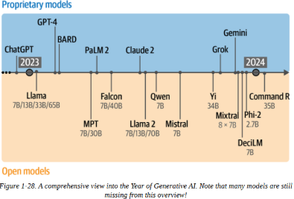
The Year of Generative AI
2023 is referred to as the Year of Generative AI.
The below illustration shows how fast and when these proprietary and open-source models have made their way to the public.

Slide 32
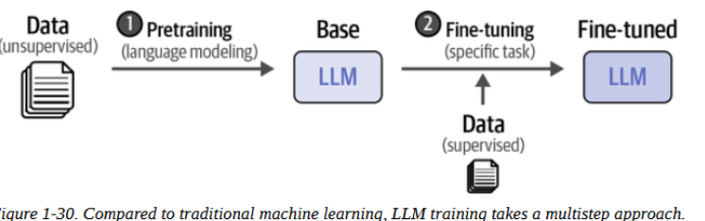
The Training Paradigm of Large Language Models
Creating LLMs typically consists of 2 steps:
Language Modeling: called pretraining, this training plase is directed to predicting the next word - without any specific task. The result is called base or foundation model.
Fine-tuning: sometimes called post-training, using the base model and further training it for a more specific task.

Slide 33
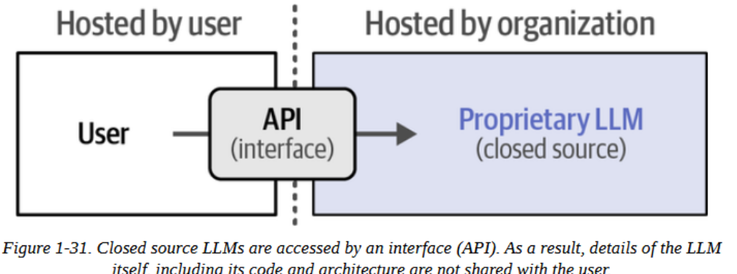
Proprietary, Private Models
Also called closed source.
Weights and architecture are not shared with the public
Popular examples: ChatGPT, Claude, Gemini.
Accessed through an interface that communicates with the LLM, called API.

Slide 34
Proprietary, Private Models
Benefits:
Users do not need powerful GPUs to use proprietary models, provider handles hosting and running the model.
Users do not need software skills to access these models.
Proprietary models tend to be more powerful due to resources and fees.
Disadvantages:
Usage costs
Cannot be fine tuned (usually)
Data is shared with the provider

Slide 35
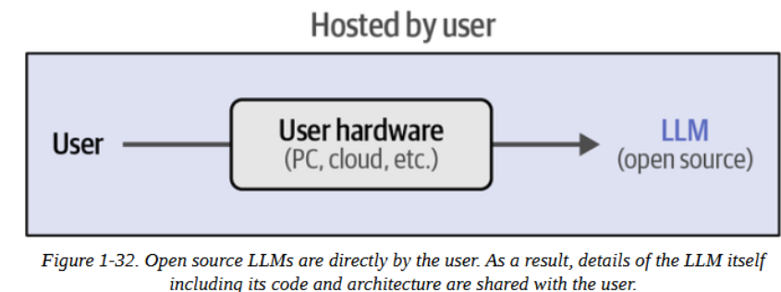
Open Models
Also called open source.
Weights and architecture are shared with the public
With powerful enough GPUs, these models can be downloaded locally.
Users have autonomy in that they are free to finetune it for specific tasks, run it locally, share sensitive data, and have complete transparency of its processes.

